Slide 1
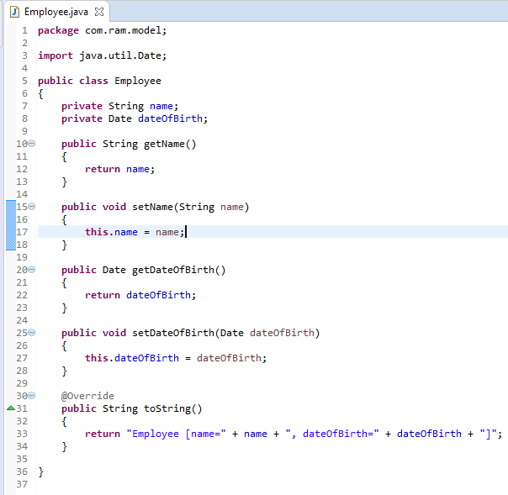
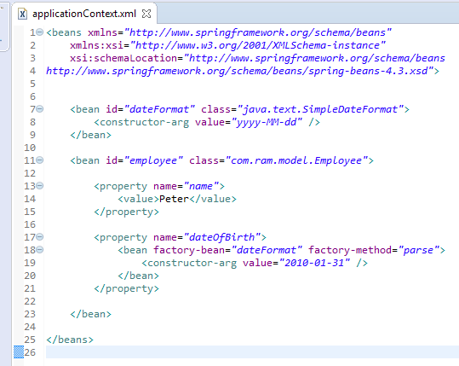
How to inject Date into bean property using Factory bean in Spring
Declare a dateFormat bean, in “employee” bean, reference “dateFormat” bean as a factory bean.
The factory method will call SimpleDateFormat.parse() to convert String into Date object automatically.

Slide 2
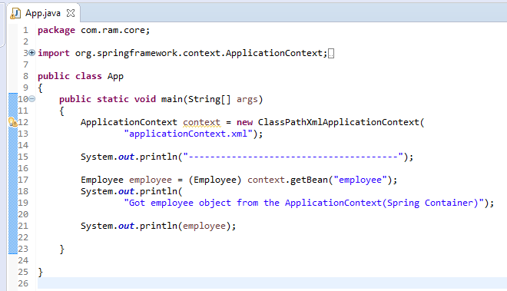
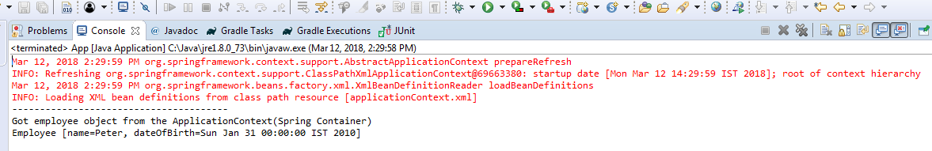
How to inject Date into bean property using Factory bean in Spring

